Slide 1
Object Oriented Design

Slide 2
Object Orientation
Traditional procedural systems separate data and procedures, and model these separately
Object orientation –views data and fns together; data abstraction is the basis
The purpose of OO design is to define the classes in the system to be built and their relationships

Slide 3
OOA and OOD
OO techniques can be used in analysis (req) as well as design
The methods and notations are similar
In OOA we model the problem, while in OOD we model the solution
Often OOA structures are subsumed in the solution domain structures
The line between OOA and OOD is not fixed

Slide 4
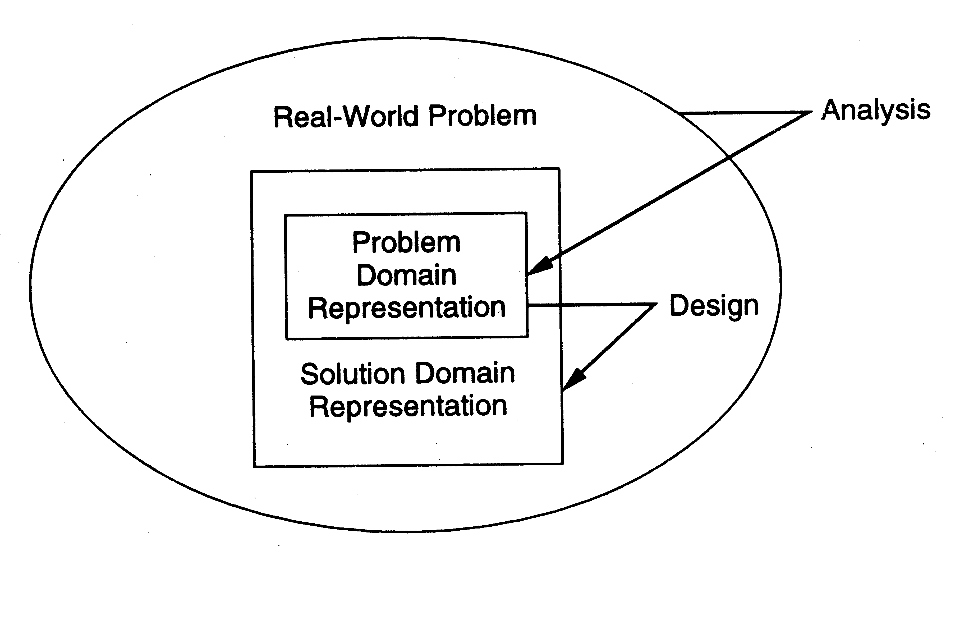
OOA and OOD…

Slide 5
OO Concepts
Encapsulation – grouping of related ideas into one unit which we can refer to by a single name
  Eg. procedures, funs, packages
In OO, object is the unit; encapsulates state and provides interface to access and modify

Slide 6
OO Concepts..
Information hiding – use encapsulation to restrict external visibility
OO encapsulates the data, provides limited access, visibility
Info hiding can be provided without OO – is an old concept

Slide 7
OO Concepts…
State retention – fns, procedures do not retain state; an object is aware of its past and maintains state
Identity – each object can be identified and treated as a distinct entity
Behavior – state and services together define the behavior of an object, or how an object responds

Slide 8
OO Concepts..
Messages – through which a sender obj conveys to a target obj a request
For requesting O1 must have – a handle for O2, name of the op, info on ops that O2 requires
General format O2.method(args)

Slide 9
OO Concepts..
Classes – a class is a stencil from which objects are created; defines the structure and services. A class has
  An interface which defines which parts of an object can be accessed from outside
  Body that implements the operations
  Instance variables to hold object state
Objects and classes are different; class is a type, object is an instance
State and identity is of objects

Slide 10
OO Concepts – access
Operations in a class can be
  Public: accessible from outside
  Private: accessible only from within the class
  Protected: accessible from within the class and from within subclasses
There are some constructor and destructor operations

Slide 11
Inheritance
Inheritance is unique to OO and not there in function-oriented languages/models
Inheritance by class B from class A is the facility by which B implicitly gets the attributes and ops of A as part of itself
Attributes and methods of A are reused by B
When B inherits from A, B is the subclass or derived class and A is the base class or superclass

Slide 12
Inheritance..
A subclass B generally has a derived part (inherited from A) and an incremental part (is new)
Hence, B needs to define only the incremental part
Creates an “is-a” relationship – objects of type B are also objects of type A

Slide 13
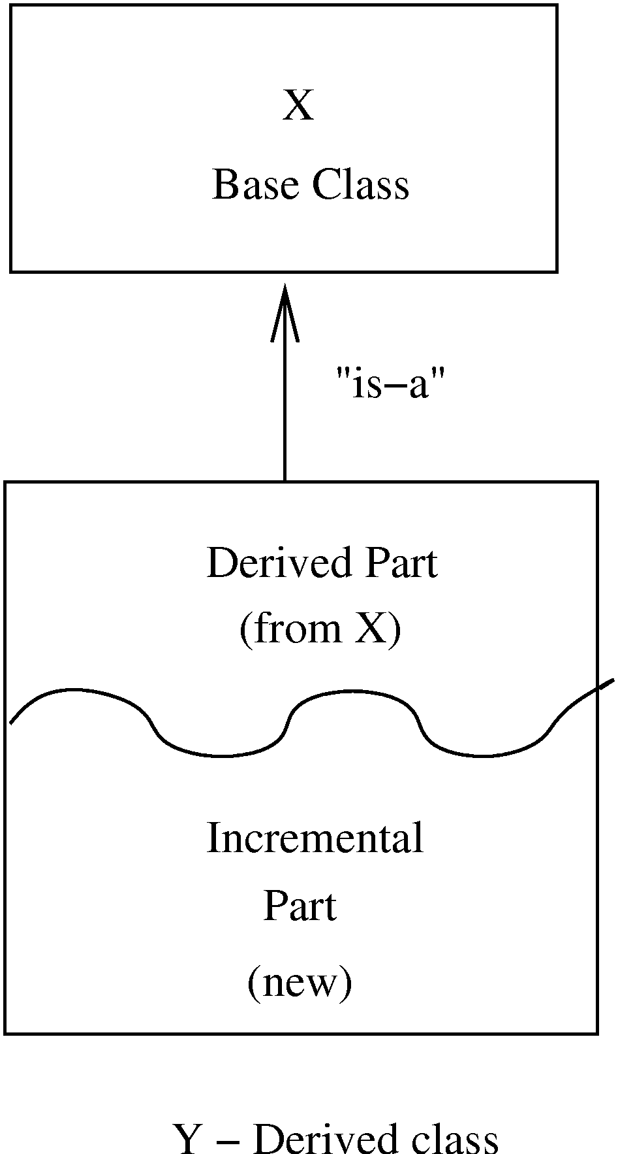
Inheritance…

Slide 14
Inheritance…
The inheritance relationship between classes forms a class hierarchy
In models, hierarchy should represent the natural relationships present in the problem domain
In a hierarchy, all the common features can be accumulated in a superclass
An existing class can be a specialization of an existing general class – is also called generalization-specialization relationships

Slide 15
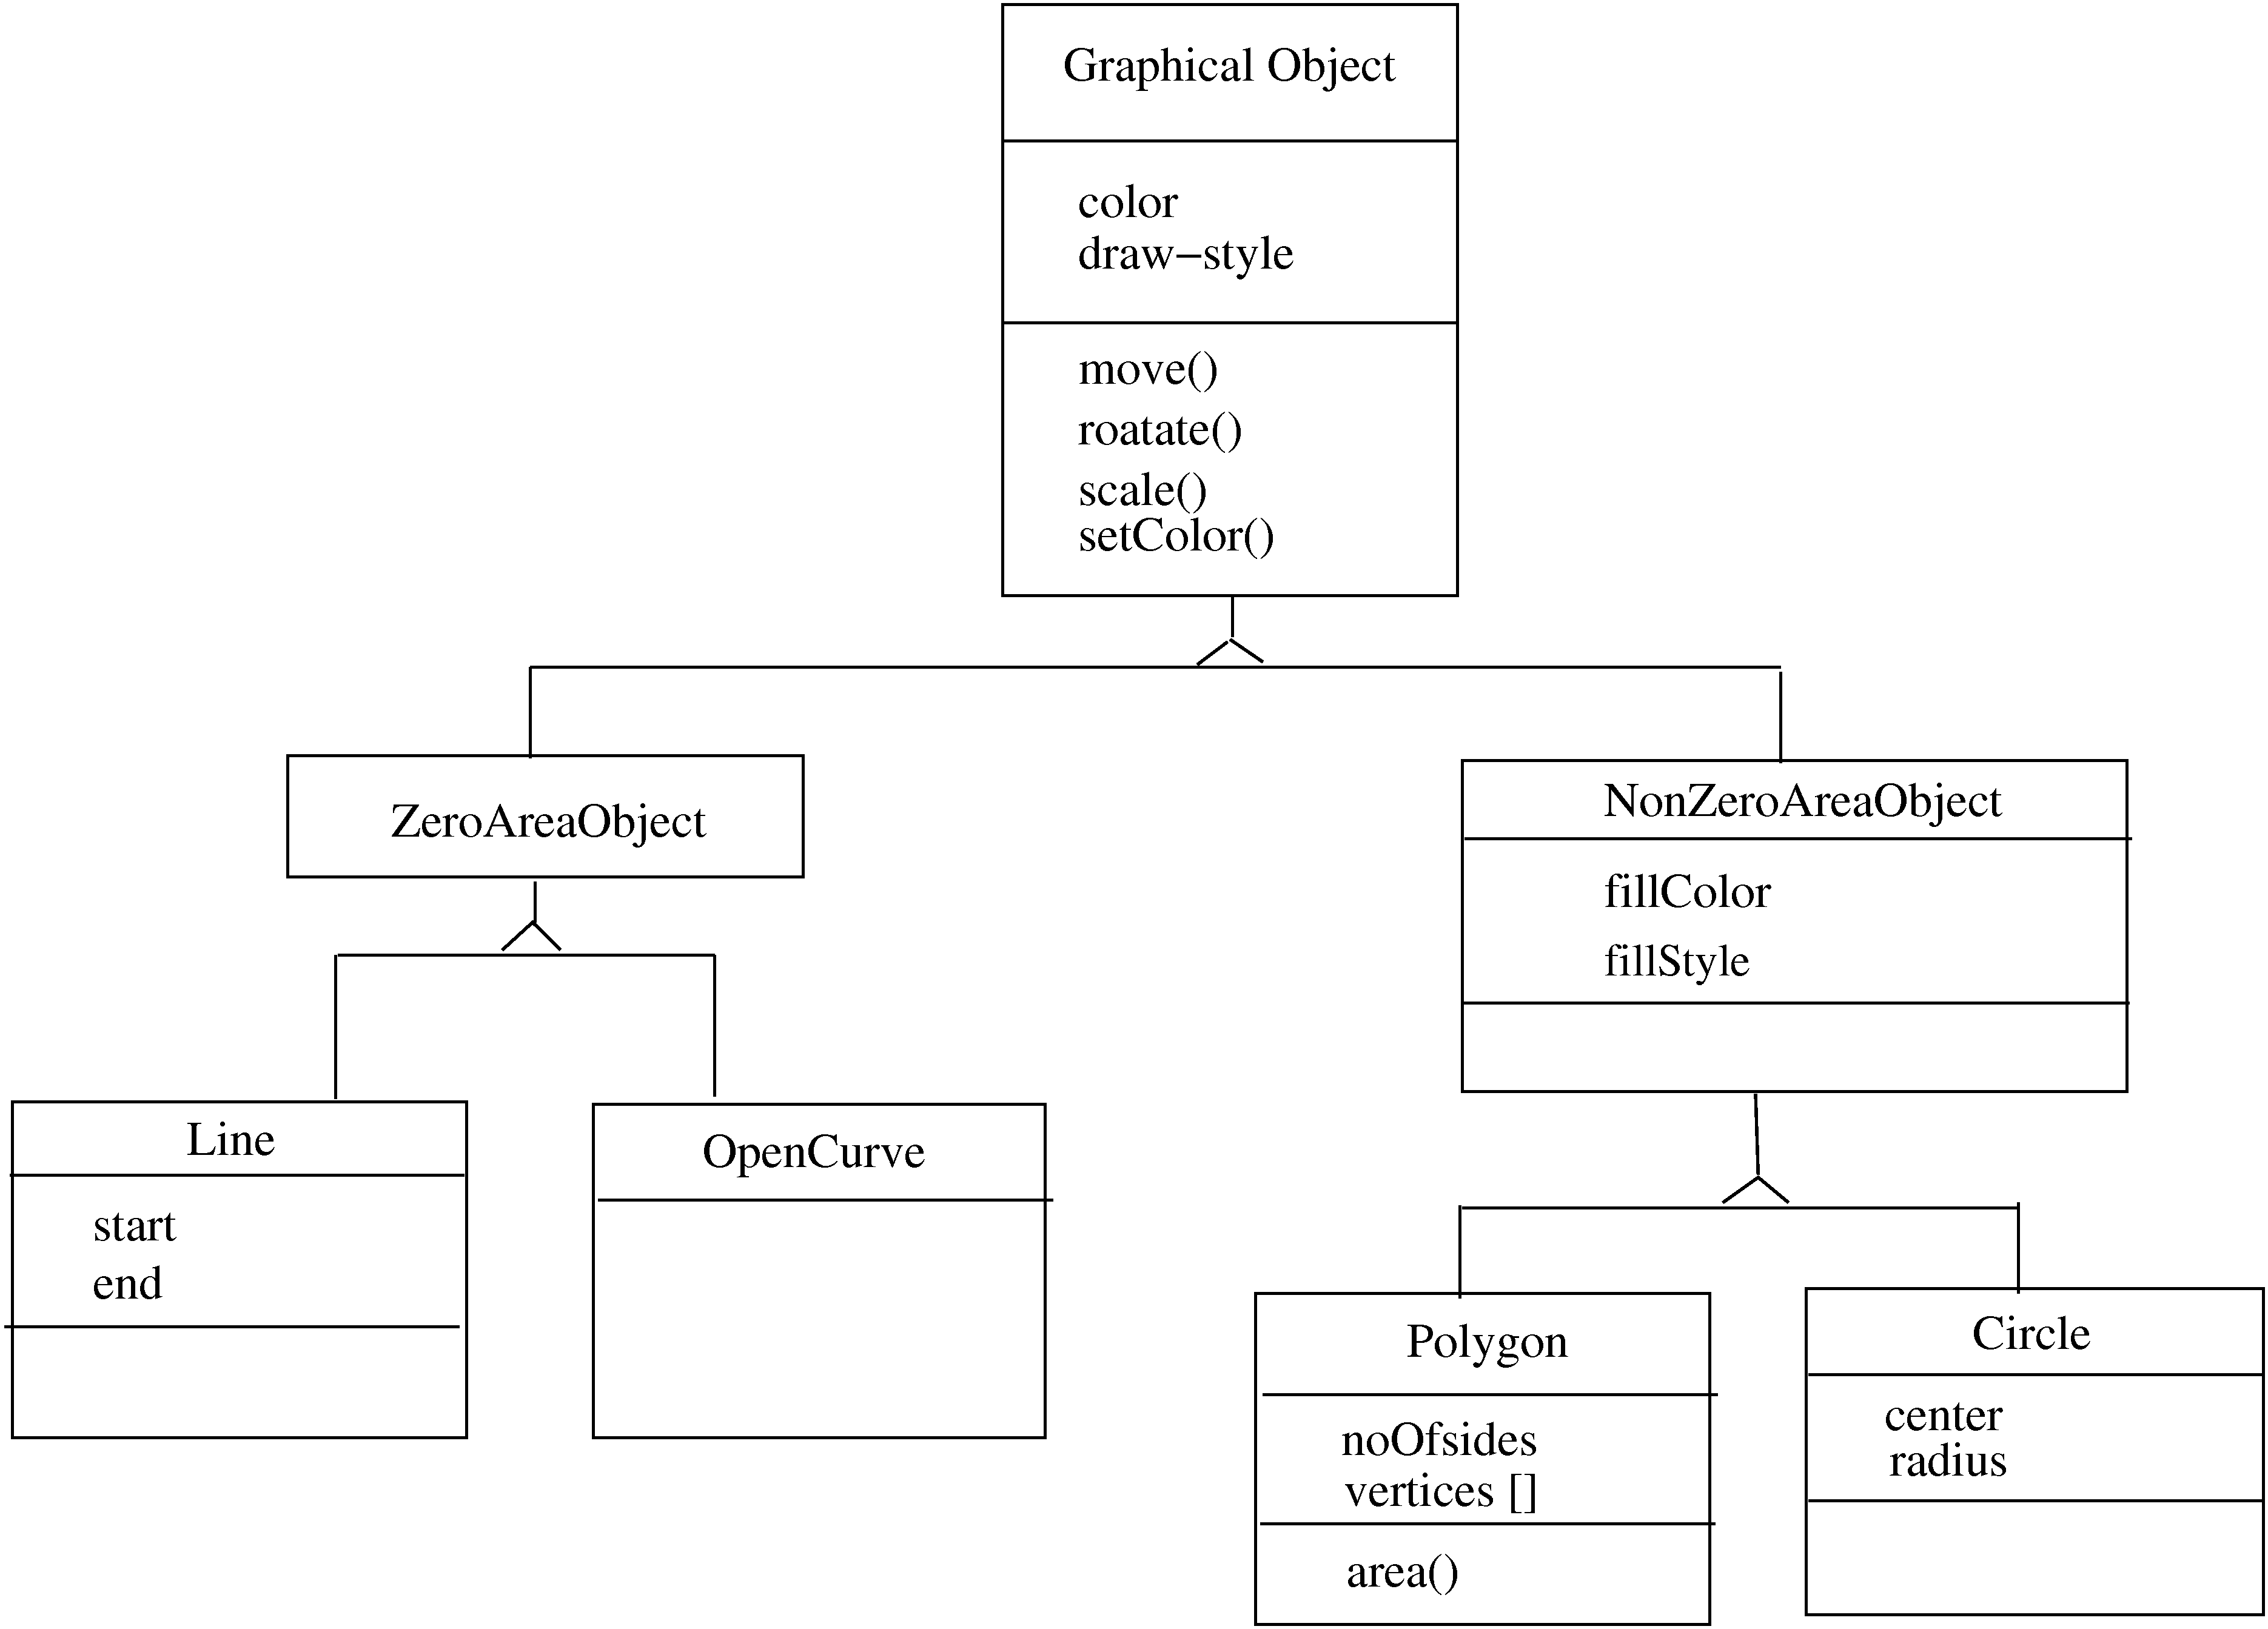

Slide 16
Inheritance…
Strict inheritance – a subclass takes all features of parent class
Only adds features to specialize it
Non-strict: when some of the features have been redefined
Strict inheritance supports “is-a” cleanly and has fewer side effects

Slide 17
Inheritance…
Single inheritance – a subclass inherits from only one superclass
  Class hierarchy is a tree
Multiple inheritance – a class inherits from more than one class
  Can cause runtime conflicts
  Repeated inheritance - a class inherits from a class but from two separate paths

Slide 18
Inheritance and Polymorphism
Inheritance brings polymorphism, i.e. an object can be of different types
An object of type B is also an object of type A
Hence an object has a static type and a dynamic type
  Implications on type checking
  Also brings dynamic binding of operations which allows writing of general code where operations do different things depending on the type

Slide 19
Module Level Concepts
Basic modules are classes
During design key activity is to specify the classes in the system being built
Correctness of design is fundamental
But design should also be “good” – efficient, modifiable, stable, …
Can evaluate a design using coupling, cohesion, and open-closed principle

Slide 20
Coupling
Coupling is an inter-module concept, captures the strength of interconnection between modules
More tightly coupled the modules, the more they depend on each other, more difficult to modify one
Low coupling is desirable for making systems understandable and modifiable
In OO, three types of coupling exists – interaction, component, and inheritance

Slide 21
Coupling…
Interaction coupling occurs due to methods of a class invoking methods of other classes
  Like calling of functions
  Worst form if methods directly access internal parts of other methods
  Still bad if methods directly manipulate variables of other classes
  Passing info through tmp vars is also bad

Slide 22
Coupling…
Least interaction coupling if methods communicate directly with parameters
  With least number of parameters
  With least amount of info being passed
  With only data being passed
I.e. methods should pass the least amount of data, with least no of parms

Slide 23
Coupling…
Component coupling – when a class A has variables of another class C
  A has instance vars of C
  A has some parms of type C
  A has a method with a local var of type C
When A is coupled with C, it is coupled with all subclasses of C as well
Component coupling will generally imply the presence of interaction coupling also

Slide 24
Coupling…
Inheritance coupling – two classes are coupled if one is a subclass of other
Worst form – when subclass modifies a signature of a method or deletes a method
Coupling is bad even when same signature but a changed implementation
Least, when subclass only adds instance vars and methods but does not modify any

Slide 25
Cohesion
Cohesion is an intra-module concept
Focuses on why elements are together
  Only elts tightly related should exist together in a module
  This gives a module clear abstraction and makes it easier to understand
Higher cohesion leads to lower coupling – many interacting elements are in the module
Goal is to have higher cohesion in modules
Three types of cohesion in OO – method, class, and inheritance

Slide 26
Cohesion…
Method cohesion – why diff code elts are together in a method (like cohesion in functional modules)
  Highest form is if each method implements a clearly defined function with all elts contributing to implementing this function
  Should be able to state what the module does by a simple statement

Slide 27
Cohesion…
Class cohesion – why diff attributes and methods are together in a class
  A class should represent a single concept with all elts contributing towards it
  Whenever multiple concepts encapsulated, cohesion is not as high
  A symptom of multiple concepts – diff gps of methods accessing diff subsets of attributes

Slide 28
Cohesion…
Inheritance cohesion – focuses on why classes are together in a hierarchy
  Two reasons for subclassing – generalization-specialization and reuse
  Cohesion is higher if the hierarchy is for providing generalization-specialization

Slide 29
Open-closed Principle
Principle: Classes should be open for extension but closed for modification
  Behavior can be extended to accommodate new requirements, but existing code is not modified
  I.e. allows addition of code, but not modification of existing code
  Minimizes risk of having existing functionality stop working due to changes – a very important consideration while changing code
  Good for programmers as they like writing new code

Slide 30
Open-closed Principle…
In OO this principle is satisfied by using inheritance and polymorphism
Inheritance allows creating a new class to extend behavior without changing the original class
This can be used to support the open-closed principle
Consider example of a client object which interacts with a printer object for printing

Slide 31
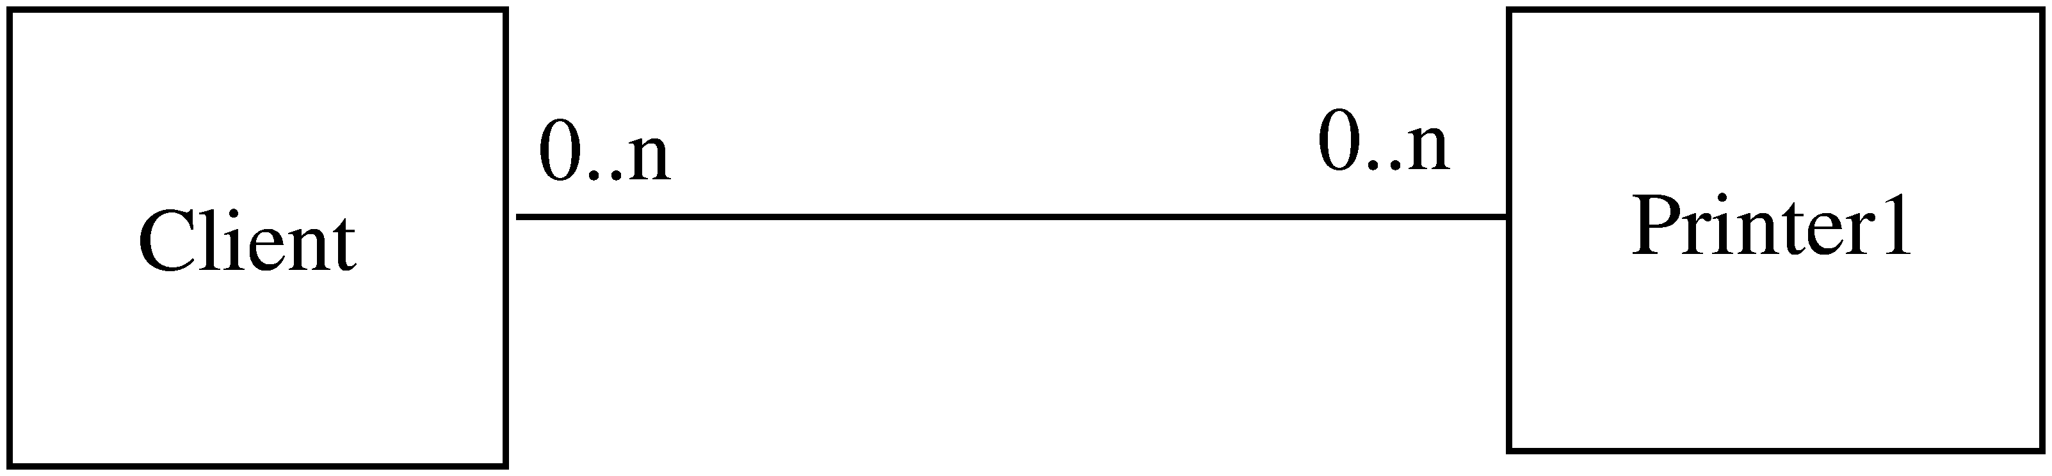
Example

Slide 32
Example..
Client directly calls methods on Printer1
If another printer is to be allowed
  A new class Printer2 will be created
  But the client will have to be changed if it wants to use Printer 2
Alternative approach
  Have Printer1 a subclass of a general Printer
  For modification, add another subclass Printer 2
  Client does not need to be changed

Slide 33
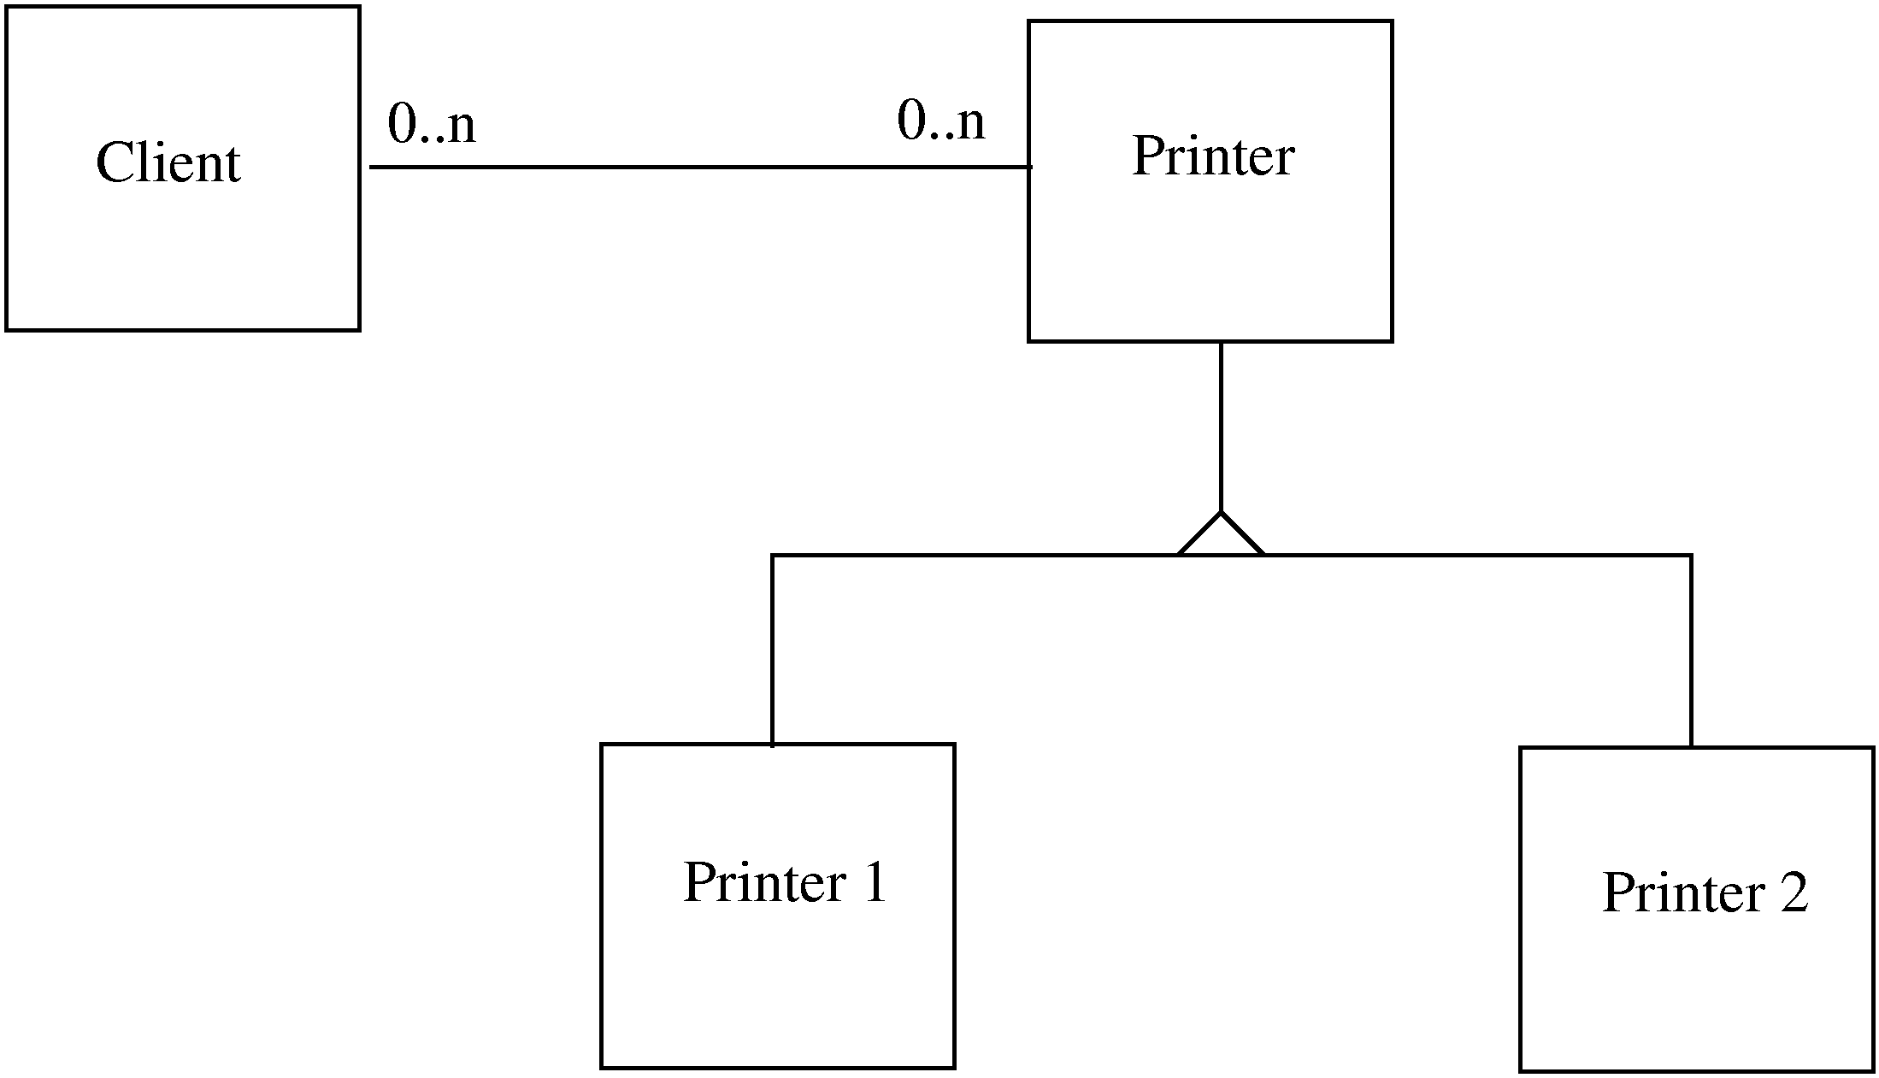
Example…

Slide 34
Liskov’s Substitution Principle
Principle: Program using object o1 of base class C should remain unchanged if o1 is replaced by an object of a subclass of C
If hierarchies follow this principle, the open-closed principle gets supported

Slide 35
Unified Modeling Language (UML) and Modeling
UML is a graphical notation useful for OO analysis and design
Allows representing various aspects of the system
Various notations are used to build different models for the system
OOAD methodologies use UML to represent the models they create

Slide 36
Modeling
Modeling is used in many disciplines – architecture, aircraft building, …
A model is a simplification of reality
“All models are wrong, some are useful”
A good model includes those elts that have broad effect and omits minor elts
A model of a system is not the system!

Slide 37
Why build models?
Models help us visualize a system
Help specify the system structure
Gives us a template that can guide the construction
Document the decisions taken and their rationale

Slide 38
Modeling
Every complex system requires multiple models, representing diff aspects
These models are related but can be studied in isolation
Eg. Arch view, electrical view, plumbing view of a building
Model can be structural, or behavioral

Slide 39
Views in an UML
A use case view
A design view
A process view
Implementation view
Deployment view
We will focus primarily on models for design – class diagram, interaction diagram, etc.

Slide 40
Class Diagrams
Classes are the basic building blocks of an OO system as classes are the implementation units also
Class diagram is the central piece in an OO design. It specifies
  Classes in the system
  Association between classes
  Subtype, supertype relationship

Slide 41
Class Diagram…
Class itself represented as a box with name, attributes, and methods
There are conventions for naming
If a class is an interface, this can be specified by <<interface>> stereotype
Properties of attr/methods can be specified by tags between { }

Slide 42
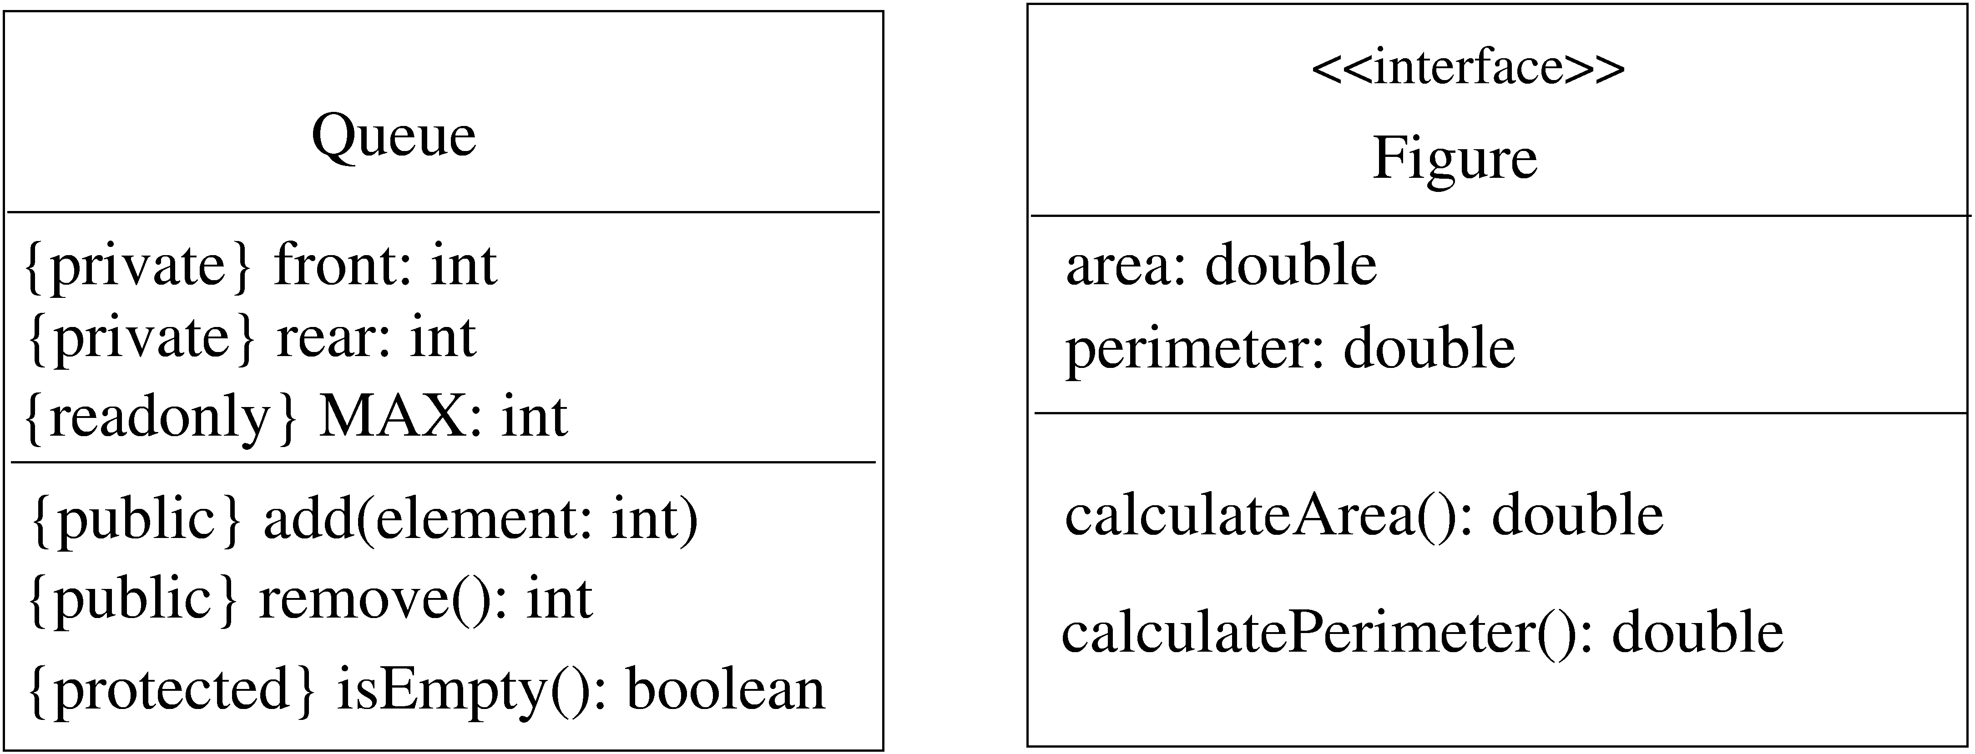
Class – example

Slide 43
Generalization-Specialization
This relationship leads to class hierarchy
Can be captured in a class diagram
  Arrows coming from the subclass to the superclass with head touching super
  Allows multiple subclasses
  If specialization is done on the basis of some discriminator, arrow can be labeled

Slide 44
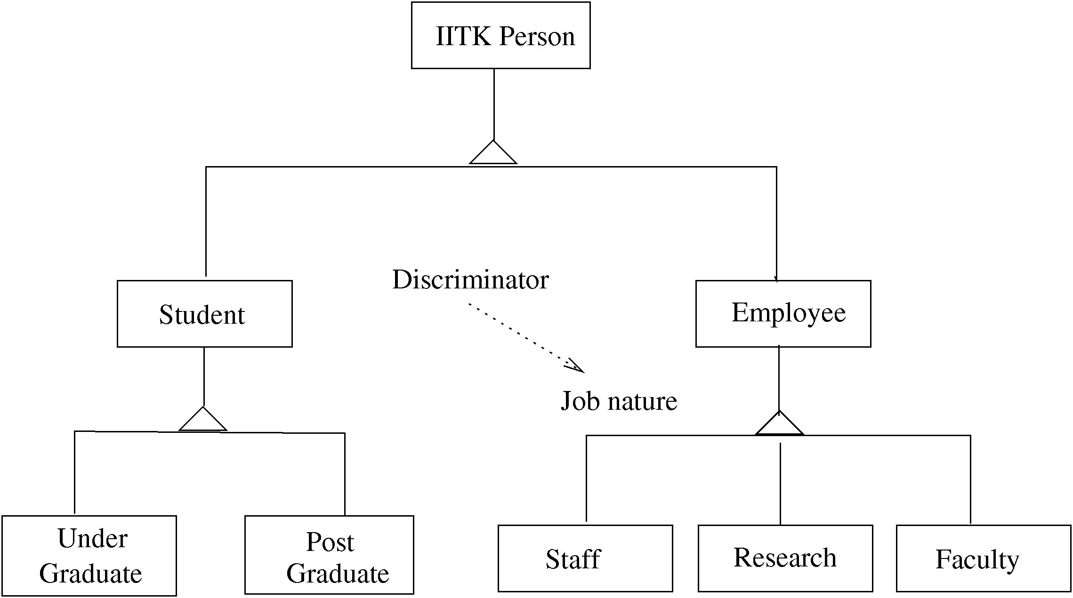
Example – class hierarchy

Slide 45
Association/aggregation
Classes have other relationships
Association: when objects of a class need services from other objects
  Shown by a line joining classes
  Multiplicity can be represented
Aggregation: when an object is composed of other objects
  Captures part-whole relationship
  Shown with a diamond connecting classes

Slide 46
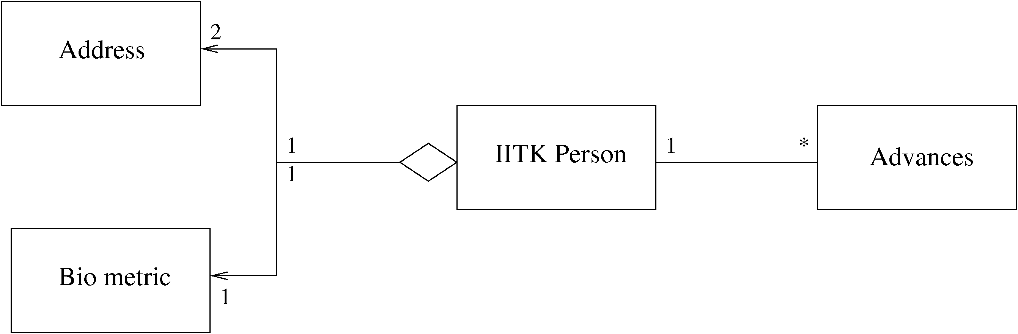
Example – association/aggregation

Slide 47
Interaction Diagrams
Class diagram represent static structure of the system (classes and their rel)
Do not model the behavior of system
Behavioral view – shows how objects interact for performing actions (typically a use case)
Interaction is between objects, not classes
Interaction diagram in two styles
  Collaboration diagram
  Sequence diagram
Two are equivalent in power

Slide 48
Sequence Diagram
Objects participating in an interaction are shown at the top
For each object a vertical bar represents its lifeline
Message from an object to another, represented as a labeled arrow
If message sent under some condition, it can be specified in bracket
Time increases downwards, ordering of events is captured

Slide 49
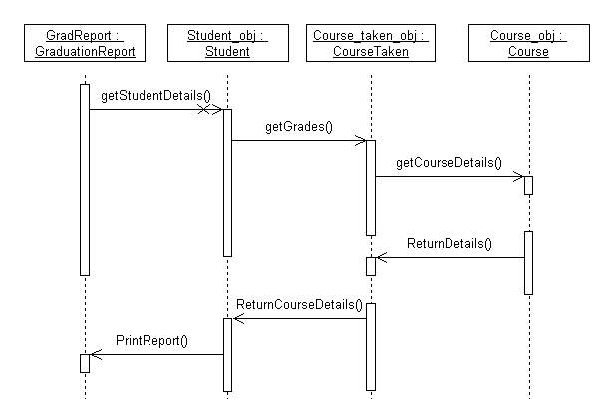
Example – sequence diag.

Slide 50
Collaboration diagram
Also shows how objects interact
Instead of timeline, this diagram looks more like a state diagram
Ordering of messages captured by numbering them
Is equivalent to sequence diagram in modeling power

Slide 51
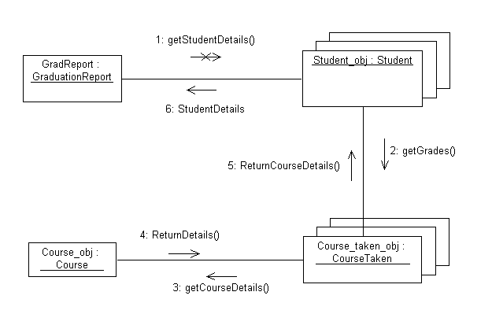
Example – collaboration diag

Slide 52
Other Diagrams
Class diagram and interaction diagrams most commonly used during design
There are other diagrams used to build different types of models

Slide 53
State Diagrams
Dynamic model to represent behavior of an individual object or a system
Shows the states of an object and transitions between them
Helps understand the object – focus only on the important logical states
State diagrams can be very useful for automated and systematic testing

Slide 54
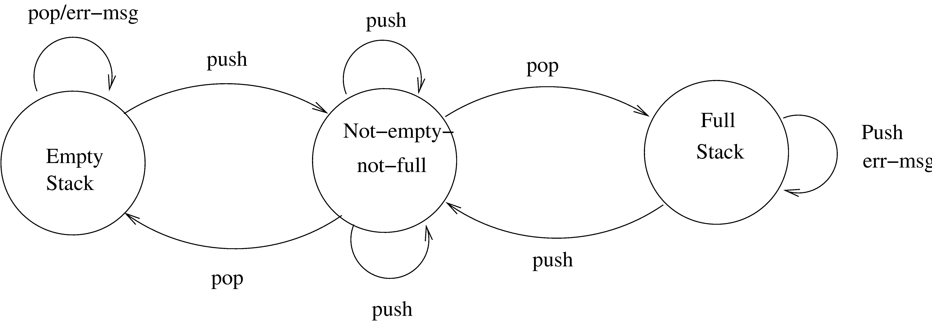
State diagram of a stack

Slide 55
Activity Diagrams
Another method for modeling the dynamic behavior
Describes the sequence of activities, and parallel behavior in a system
  Activity represented by ovals, dependence shown by inputs/outputs
Variant of a state diagram – captures the state of the system and transitions

Slide 56
Other Diagrams
Instead of objects/classes, can represent components, packages, subsystems
These are useful for developing architecture structures
UML is extensible – can model a new but similar concept by using stereotypes (by adding <<name>>)
Tagged values can be used to specify additional properties, e.g. private, readonly..
Notes can be added

Slide 57
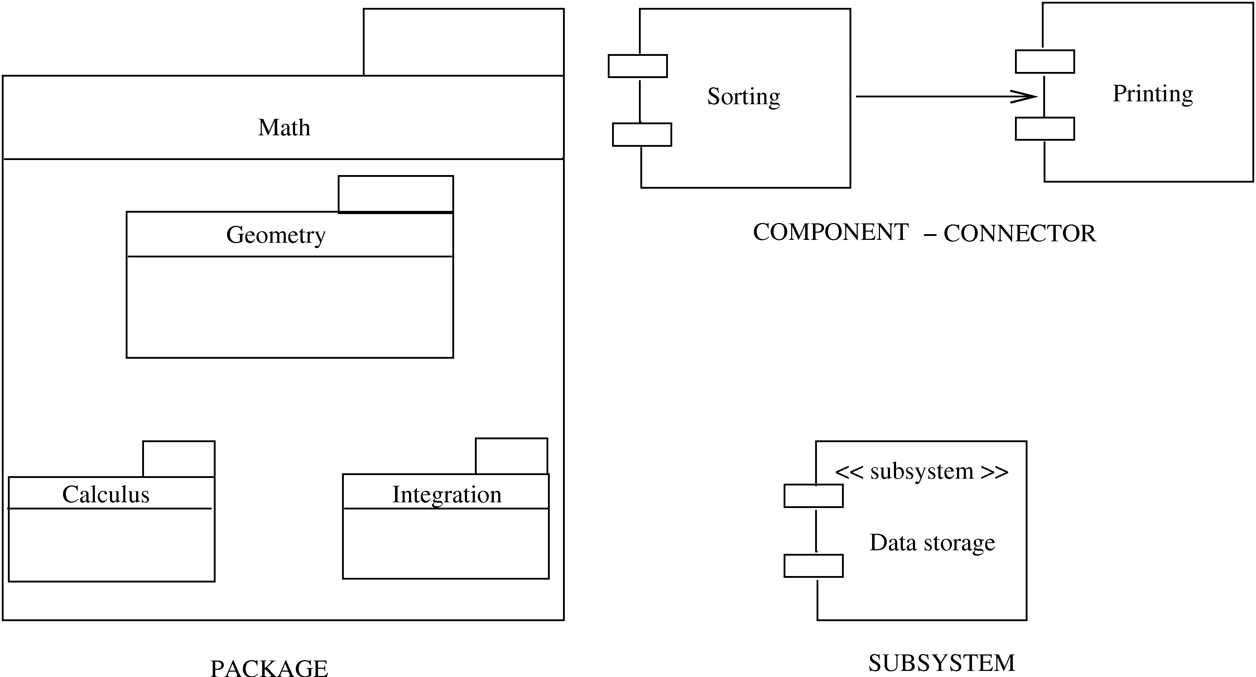
Other symbols

Slide 58
Design using UML
Many OOAD methodologies have been proposed
They provide some guidelines on the steps to be performed
Basic goal is to identify classes, understand their behavior, and relationships
Different UML models are used for this
Often UML is used, methodologies are not followed strictly

Slide 59
Design using UML
Basic steps
  Identify classes, attributes, and operations from use cases
  Define relationships between classes
  Make dynamic models for key use cases and use them to refine class diagrams
  Make a functional model and use it to refine the classes
  Optimize and package
Class diagrams play the central role; class defn gets refined as we proceed

Slide 60
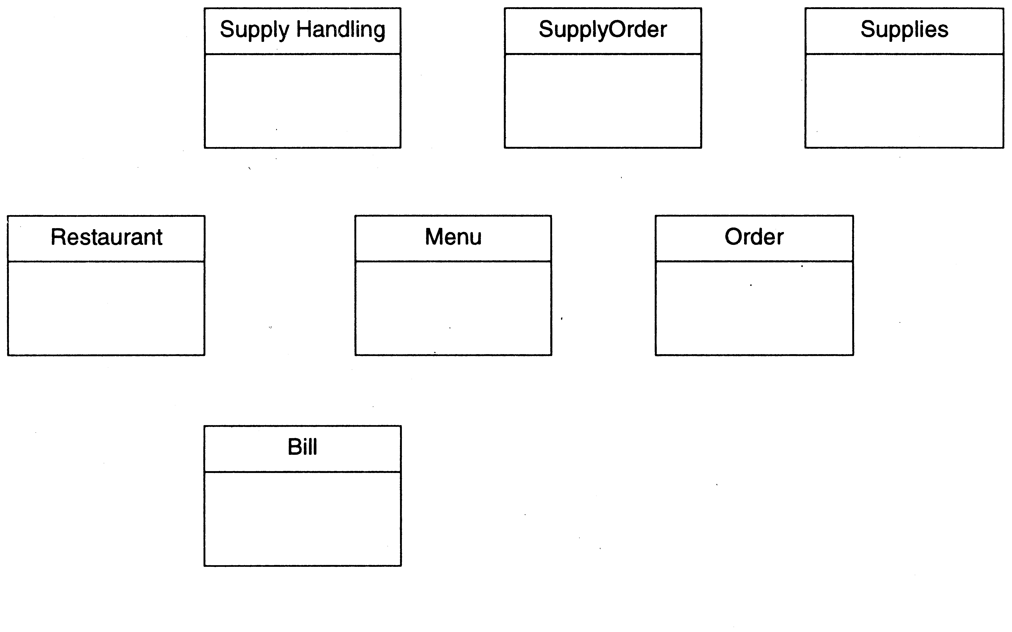
Restaurant example: Initial classes

Slide 61
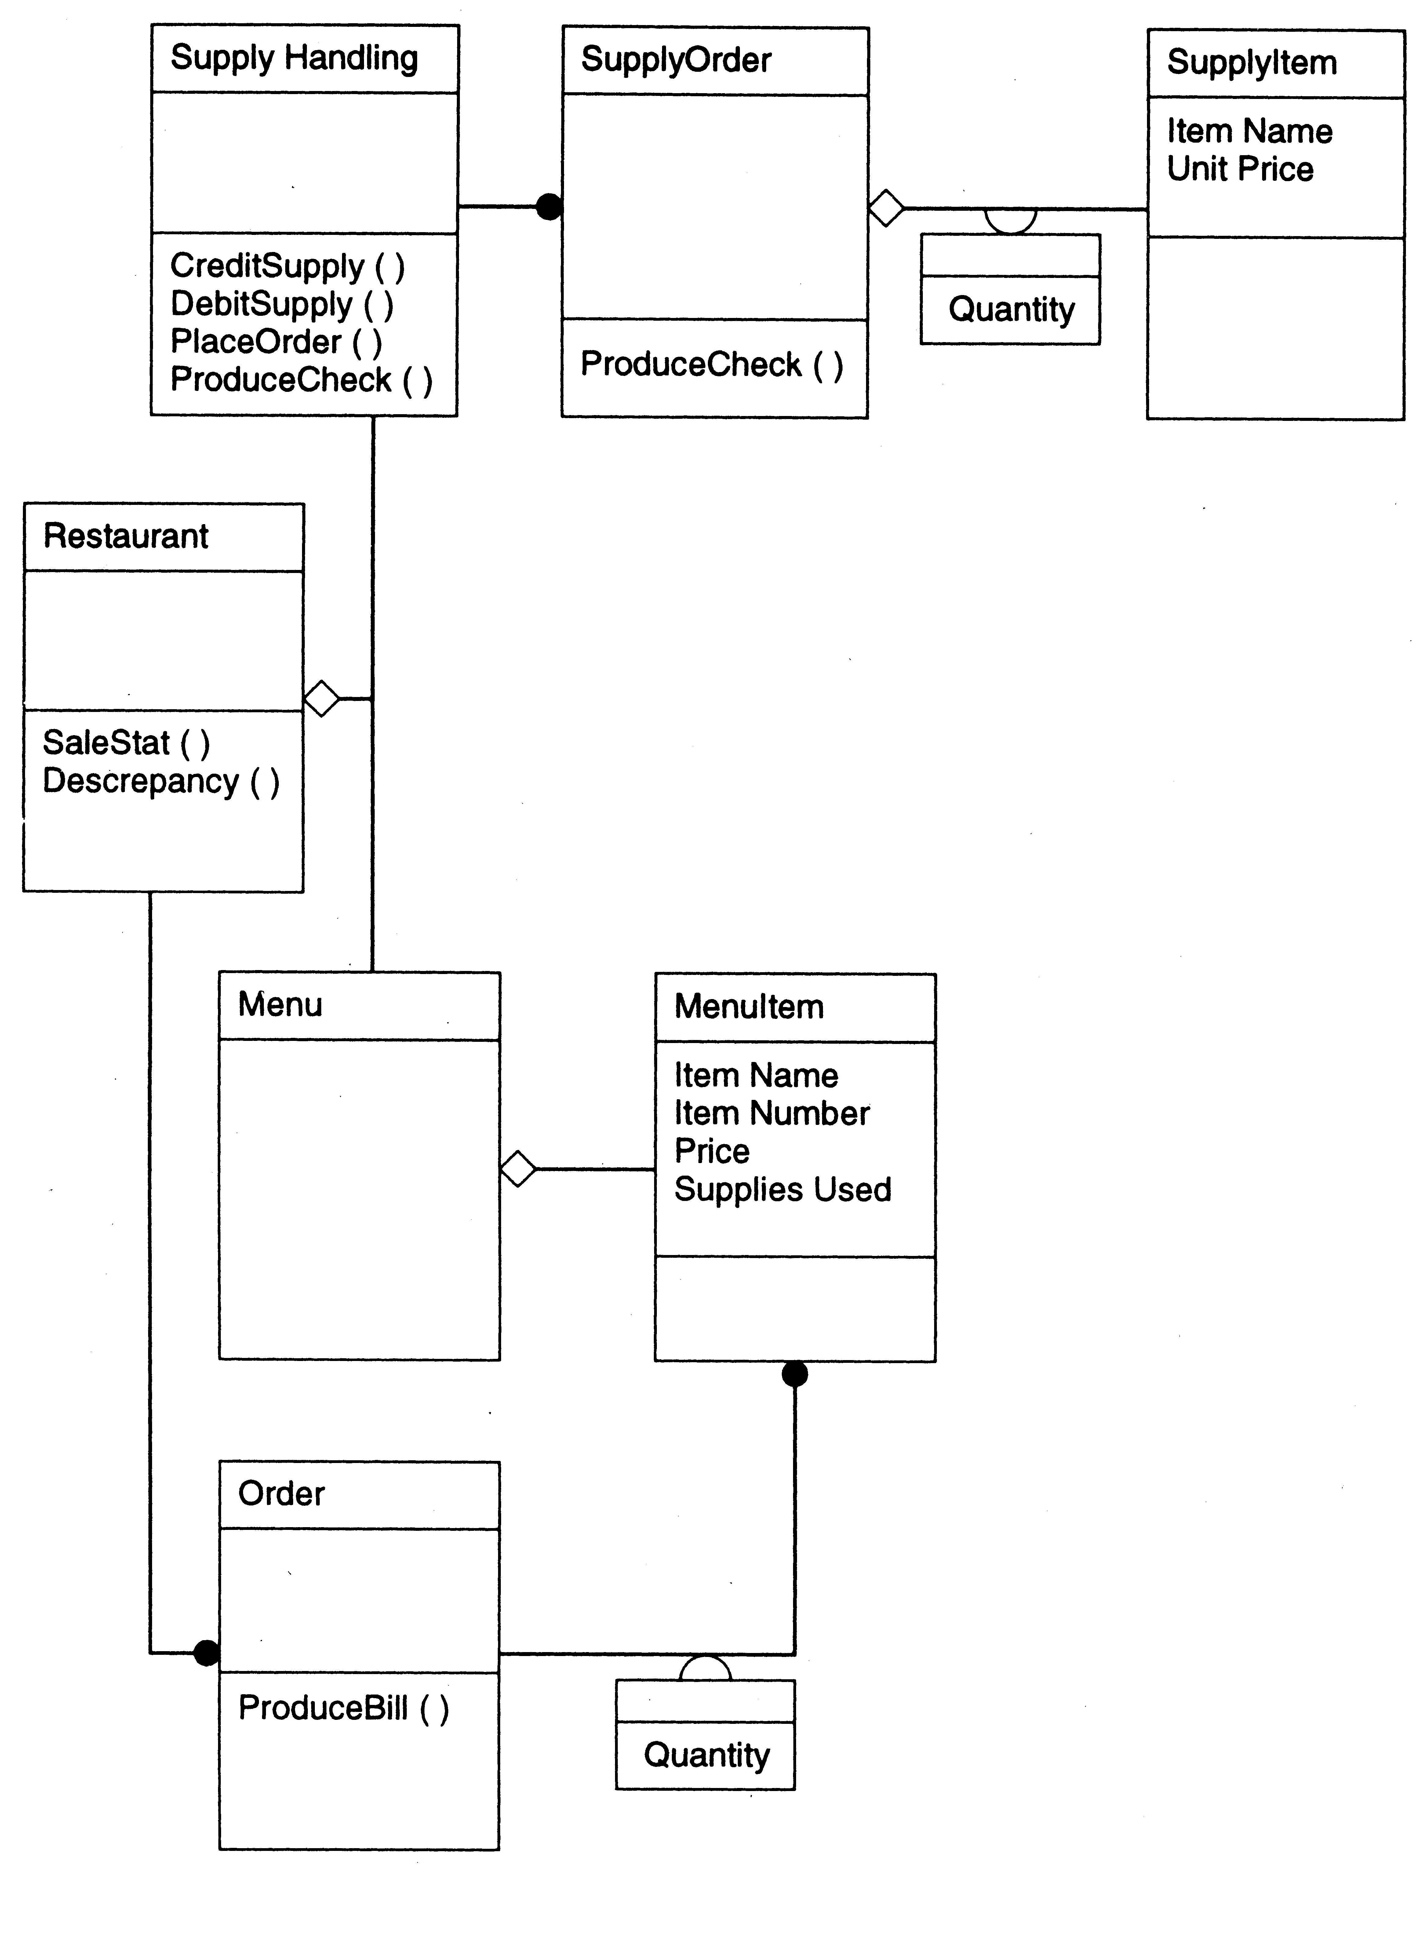

Slide 62
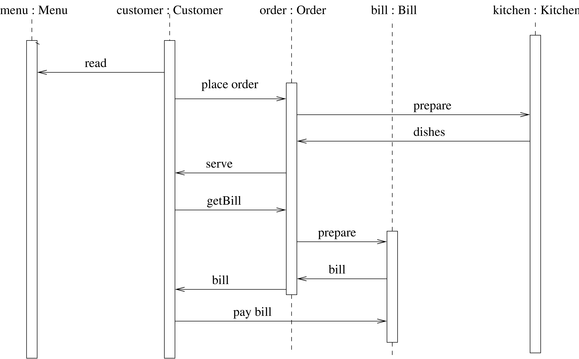
Restaurant example: a seq diag

Slide 63
Metrics
Weighted methods per class
  Complexity of a class depends on no of classes and their complexity
  Suppose complexity of methods is c1, c2..; by some functional complexity metric
  WMC = Σ ci
  Large WMC might mean that the class is more fault-prone

Slide 64
Metrics…
Depth of Inheritance Tree
  DIT of C is depth from the root class
  Length of the path from root to C
  DIT is significant in predicting fault proneness
Number of Children
  Immediate no of subclasses of C
  Gives a sense of reuse

Slide 65
Metrics…
Coupling between classes
  No of classes to which this class is coupled
  Two classes are coupled if methods of one use methods or attr of other
  Can be determined from code
  (There are indirect forms of coupling that cannot be statically determined)

Slide 66
Metrics…
Response for a class
  The total no of methods that can be invoked from this class
  Captures the strength of connections
Lack of cohesion in methods
  Two methods form a cohesive pair if they access some common vars (form a non-cohesive pair if no common var)
  LCOM is the number of method pairs that are non-cohesive – the no of cohesive pairs

Slide 67
Summary
OO is a newer paradigm, slowly replacing the functional approach
OO models both data and functions
UML is a notation that is used often to model systems in an OO manner
UML provides various diagrams for modeling the structure, dynamic behavior, etc.
Through UML modeling, design for the system can be developed

